Slide 1
Tech Scams Today
"Namquam Nimium Anticus ad Imus"
Never too Old to Learn

Slide 2
Get to Know Scammers
What Method do Scammers Use the Most to Contact Seniors?
Email
Phone Call
Text Message
Website or App

Slide 3
Get to Know Scammers
2. What Type of Payment to Scammers Receive Most from Seniors?
Check
Gift Card or Re-load Card
Credit Cards
Cash

Slide 4
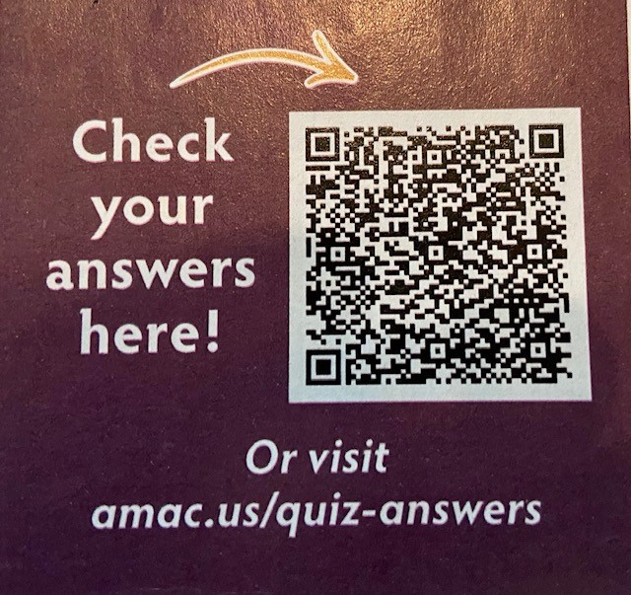
Get to Know Scammers
3. Many Scams are Used Throughout the Senior Community. Place These Scams in Order from Most Used to Least Used
___ Business Imposter
___ Tech Support
___ Government Imposter
___ Online Shopping
___ Miscellaneous Investments

Slide 5
SCAM Facts
You Are a Target for a SCAM!
$12.76 B/Year 55+ Being Scammed in US
3.3 M People Tech Scammed = $1.5 B/Yr.
Every 10 Seconds Someone is SCAMMED
80 year olds are 3X more likely than <60 year old
They Want you to Pay, Using Methods Hard to Track
If it sounds too good too be true-it’s not true!!!

Slide 6
SCAM Facts
FTC reported in 2021, $5.8B in fraud scams
Increase 70% from previous year
2022 up 30%
Older Adults are a Target for:
Romance Scams
Imposters
Identity
Home Equity
Insurance

Slide 7
South Carolina SCAM Data
2021 Top 3 Identity Theft in SC:
Financial 53.38%
Government Notification 40.54%
Crime 0.90%
Reported Identity Theft Losses 2021 $3,451,579

Slide 8
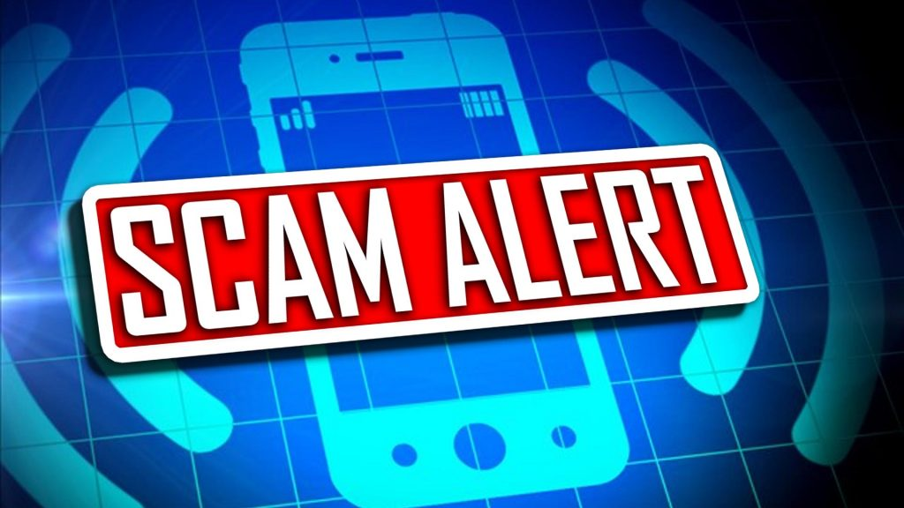
South Carolina SCAM Data
2021 Top 3 SCAMS Types in SC:
Imposter Business 57.31%
Imposter Government Agency 21.27%
Imposter Relationship 7.18%
Scams by Age: 51% people 55+ years old
55% were Phone Scams
Reported SCAM Losses 2021 $2,991,577

Slide 9
South Carolina SCAM Data
2022 Top SCAMS in SC:
Lottery/Prizes/Sweepstakes
Purchase
Crime/Warrant/Dating

Slide 10
Why do They SCAM?
Bad People, Doing Bad Things to Good People
They Want Your Money & Identity
Play on Your Emotions
Could be Local or International
Never Give Out
Social Security #
Bank Acct # PIN#
Investment Acct#
Drivers License #
Usernames/Passwords
Credit/Debit Card #

Slide 11
Contacts Are Important
Enter Important Names (Contacts) in Your Phone
Family
Friends
Doctors
Lawyer
Accountant
Church
Other?
Phone Numbers, Email, Addresses, Birthday, and More!

Slide 12
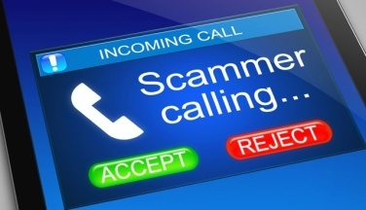
Phone Scams
Stranger Danger
Scammers will call, text, or use robo calls to trick you into revealing personal information
The “Golden Rule” of Phone Scams
Things to “Listen for”
The “One Ring” Call
The Call from “Your” Phone Number
Ghost Calling

Slide 13
Vishing
Scams from Phone Calls
Appears to be from a Reliable Source
Asking as am Official Business, Requesting Personal Information
Trying to Get You to Say “Yes” of “No”-Recorded Out of Context
Solution
Never Answer the Phone from an Unknown Number
Block Unwanted Callers & Delete

Slide 14
SCAM ALERT
Voice Cloning
Scammers are Recording Voices (only a few seconds)
Using Artificial Intelligence (AI) to Modify Message to Scam You
It Sounds Like a Person You Know (Family, Friend)
Solution
Although it May Look Like the Phone Number and Sounds Like the Person-Verify!
Call them back-Do Not Call via Reply of Call Back Feature
Have a Safe Word
Ask Personal Questions
Call Another Family Member or Friend
Make Your Social Media Accounts Private

Slide 15
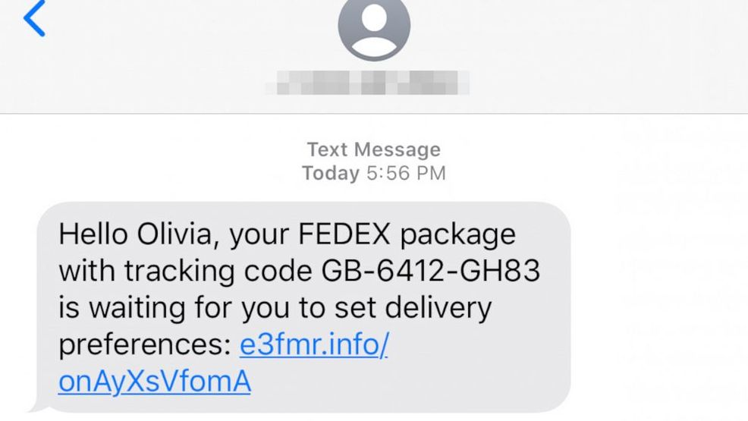
Text Scams
Typically Takes You to Another Website
Do NOT Click on Anything!
They want you to confirm something-NO!
Watch for poor grammar and misspelled words
Pretend to represent a “real” company, organization, government, agency, etc..

Slide 16
Smishing
Fraud Via Text Messages
Text Message Asks You to Click on Something/Link
Asks You for Personal Information
Potential for Bad Guys to Download Viruses and Malware-Results in Stealing Information on Your Device
Solution
Don’t Respond or Click on Anything from Someone You Don’t Know
Block Number & Delete Text

Slide 17
SCAM ALERT
Social Security Scams
Steal Your Benefits and Personal Information
Phone Call
Your SS number has been suspended, linked to a crime
Want you to confirm your SS # on phone-Never!!!
Claim they will reissue a new number for a fee
Office Closures
Receive a letter SS office has closed, call number in letter
Scammer manipulates you to share personal information, wants you to pay a fee

Slide 18
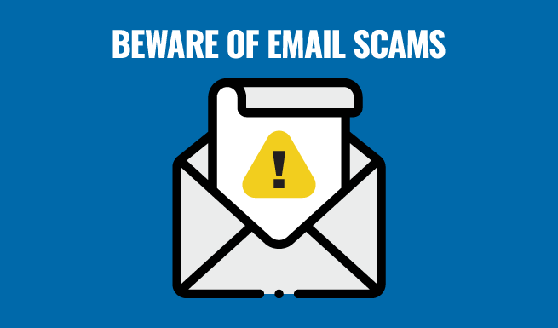
Email Scams
Phishing/Spoofing
Check email address (hover over email address)
Do NOT click on anything!
Asking to confirm something-NO!
Watch for poor grammar and misspelled words
Pretend to represent a “real” company, organization, government, agency, etc..

Slide 19
Phishing
Cyber Attaches Through Email
Email Looks Legitimate-Logo, colors, message
Requesting or Updating Your Username, Password, Account
Claiming You Have a Problem-Account, Lost Package, Need Immediate Response
Solution
If you did not request a new password, account, etc-it’s a SCAM
Set up Two Factor Authentication on All of Your Accounts
Check Email Senders Address-Hover Over Address

Slide 20
Identity Scams
Phone
Someone requesting personal information
Credit/Debit Card Skimming
Devices intercept your card information
Wi-Fi
Using public W-Fi on your device
Medical Records
Frequently check your records and insurance provider
Data Breaches
Frequently check your bank, credit card and investment accounts
Tax Fraud
What if a criminal files a tax return in your name, 180 to resolve

Slide 21
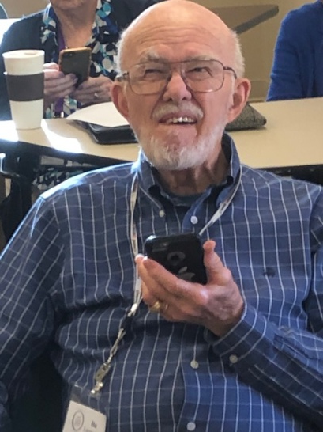
SCAM ALERT
Grandparent Scam
Phone call claiming to be a family member in serious trouble & needs money immediately. Trying to create confusion and urgency!
Mugged, jail, stranded
Confirm Caller
Ask Questions
Never Give Out Personal Information
Never Rush into a Financial Decision

Slide 22
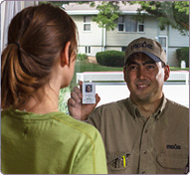
In Person Scams
Don’t Open Your Door to Strangers
Donation/Fundraising
Phone/Cable/Utilities
Household Services
Lawn
Roof
Paint
And More!

Slide 23
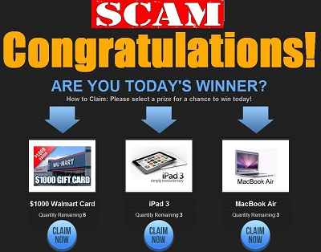
Types of Scams
Social Media-Face Book
Debt Collection
Government Official/IRS
Bank/Credit Card
Loan/Credit
Prizes, Sweepstakes, Gifts, Lottery
Internet Purchase
Auto-Loan, Buying, Credit, Repairs, Warranties
Credit Bureaus

Slide 24
SCAM ALERT
IRS IMPOSTER SCAM
Starts with a Call, Text, Email or Letter in Mail
Claim You Owe IRS Money & Demand Payment Right Away
Want You to Pay via Wire Transfer, Pre Paid Credit /Debit Card, Gift Card
Verify Your Information
Send You an Email or Text Message
Want You to Verify by Clicking on Website –NO!!!

Slide 25
SCAM ALERT
IRS SCAMS
Things the IRS will NEVER do:
Call you to demand payment
Threaten you with law enforcement for not paying
Demand payment without question or appeal
Ask for credit or debit card over phone

Slide 26
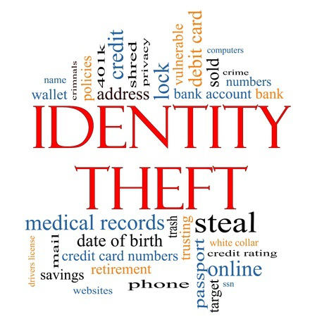
Types of Scams
Home Mortgage Scams
Fake Checks (Stimulus, Taxes, etc.)
Tech Support
On-Line Dating
Click Bait
Fake Bills/Invoices
Medical Alert
Arrest
Medical Insurance

Slide 27
SCAM ALERT
Tech Support Scam
Phone call or pop-up warning on computer screen.
Error message, software update, loud noise & flashing screen.
Claim to be Apple, Google, Microsoft-convince you to “repair” your issue remotely
Once they access your computer that will claim to fix the problem and ask for payment
Scammer has access to everything on your computer!

Slide 28
SCAM ALERT
Tech Support Scam
Don’t Be a Victim
Hang Up Phone Immediately-Block Caller
Never Click on Links or Pop-Ups
Never Give Access to Your Computer or Share Passwords
Keep Your Computer Security Software Up to Date
If Scammed
Contact Bank/Credit Card Report Fraud
Change Your Passwords Immediately

Slide 29
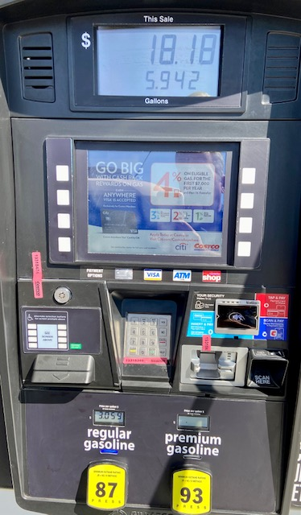
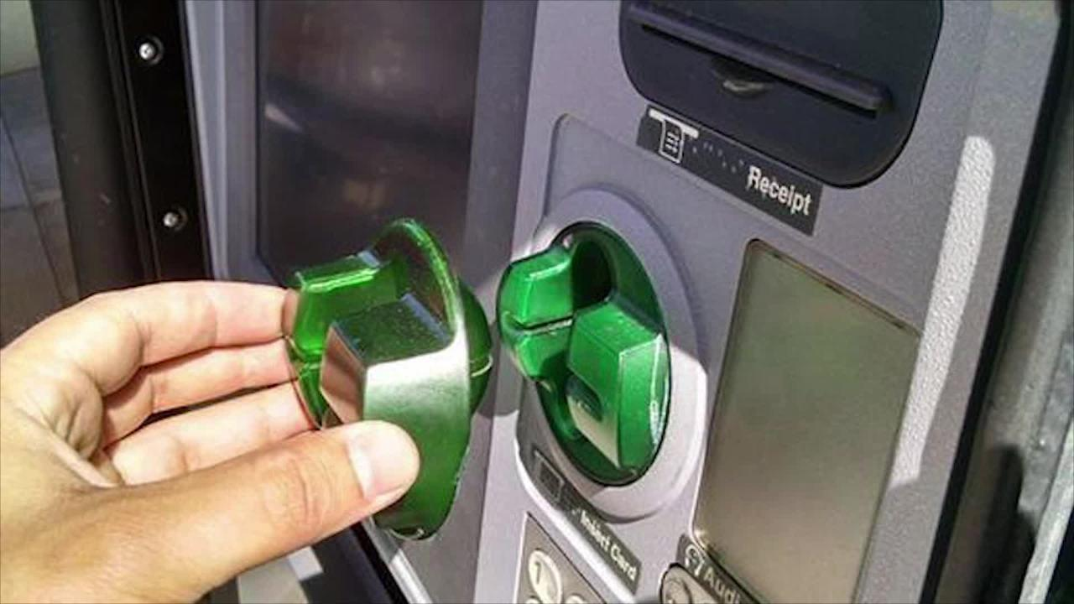
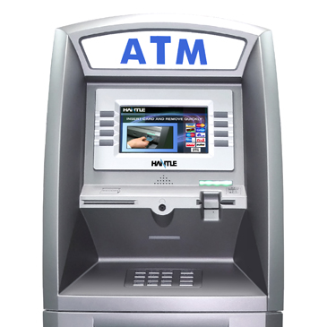
Types of Scams
Gas Pump/ATM

Slide 30
SCAM ALERT
Lottery/Prize Scam
Notified you have WON prize/lottery/sweepstakes/raffle. Issue you a check (more than owed) to help pay taxes & fees.
Prize and Raffle are Bogus
Check Issued is Fake
Never “Play to Play”
Verify Any Payment with Your Bank
Report Fraud to Your Bank

Slide 31
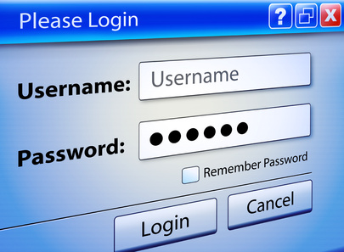
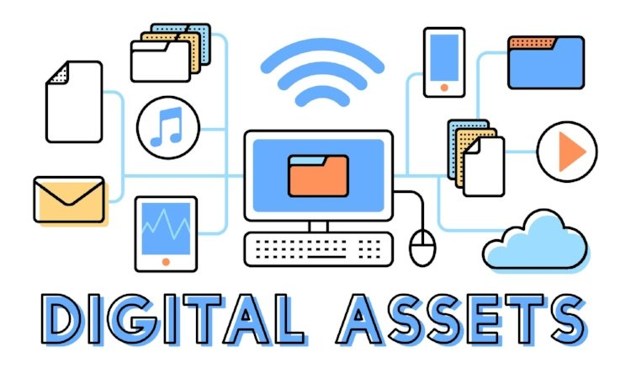
Protect Your Digital & Personal Assets
How do YOU manage YOUR Assets?
Digital Assets
Usernames/Passwords
Personal Assets
Financial
Medical
Home
Vehicles
Legal
And More

Slide 32
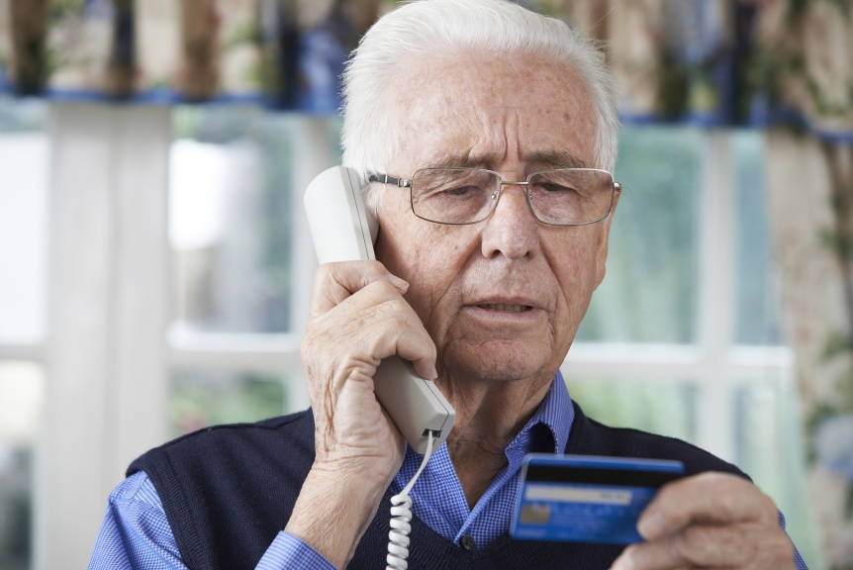
What if I am Scammed?
Recognize You Have Been Scammed
High Risk of Re-victimization
Embarrassed You Where Scammed
Fear of Loosing Independence
Third Party Reports Scam

Slide 33
What if I am Scammed?
Get Help Immediately
Tell a Trusted Friend/Family Member/Caregiver
Call Police/Sheriff
Call Bank, Credit Card, Investments & Stop Action
Check all Accounts/Mortgage
Change Password ASAP

Slide 34
Signs You May Be A Victim
Financial Accounts
Bank Account Withdrawals
Don’t get your Bills or Mail
Debt collectors calling about debts that aren’t yours
Unfamiliar information or changes on credit report
Consider contacting your bank/financial institution:
Get Text if your balance goes below a certain number
Get Text or Email, if charges are greater than a certain amount

Slide 35
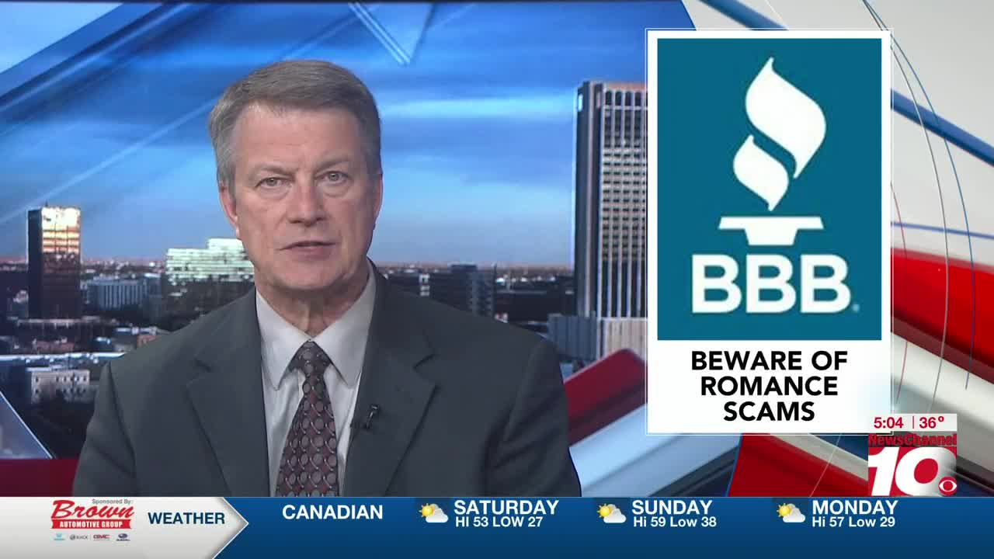
Research & Help
Federal Trade Commission
www.ftc.gov/scams
www.identitytheft.gov
Greenville County
https://www.greenvillesc.gov/1384/Fraud-and-Identity-Theft-Resources
Better Business Bureau (BBB)
https://www.bbb.org/local-bbb/bbb-of-upstate-south-carolina
South Carolina Department of Consumer Affairs
www.consumer.sc.gov 800.922.1594
AAA www.AAA/IdentityTheft
AMAC, AARP
Media- Local & National TV & News Reports

Slide 36
Operation Safe Outcomes

Slide 37
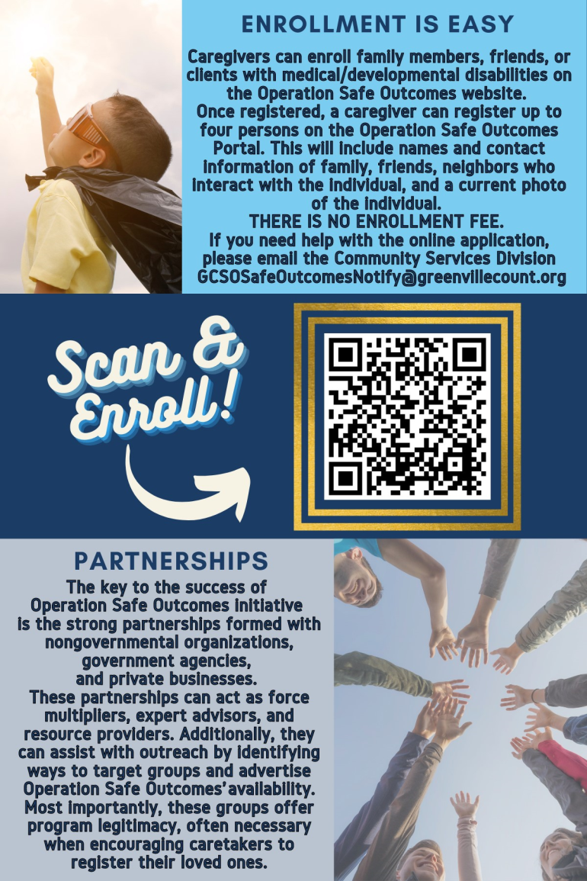
Operations Safe Outcomes
Tonya Joy
c: 864.561.3426
tjoy@greenvillecounty.org

Slide 38
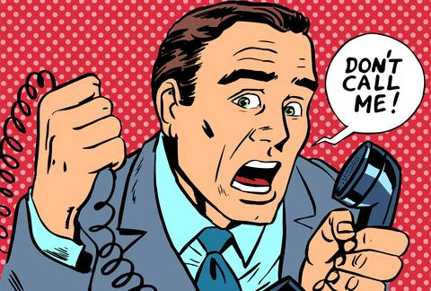
Block Scam Calls
Do Not:
Talk to Scammers!
Call Back Scam Calls!
Only Answer Phone Call from People You Know
Cell Phone and Landline (house) Phone
If it’s Important, They will Leave a Message

Slide 39
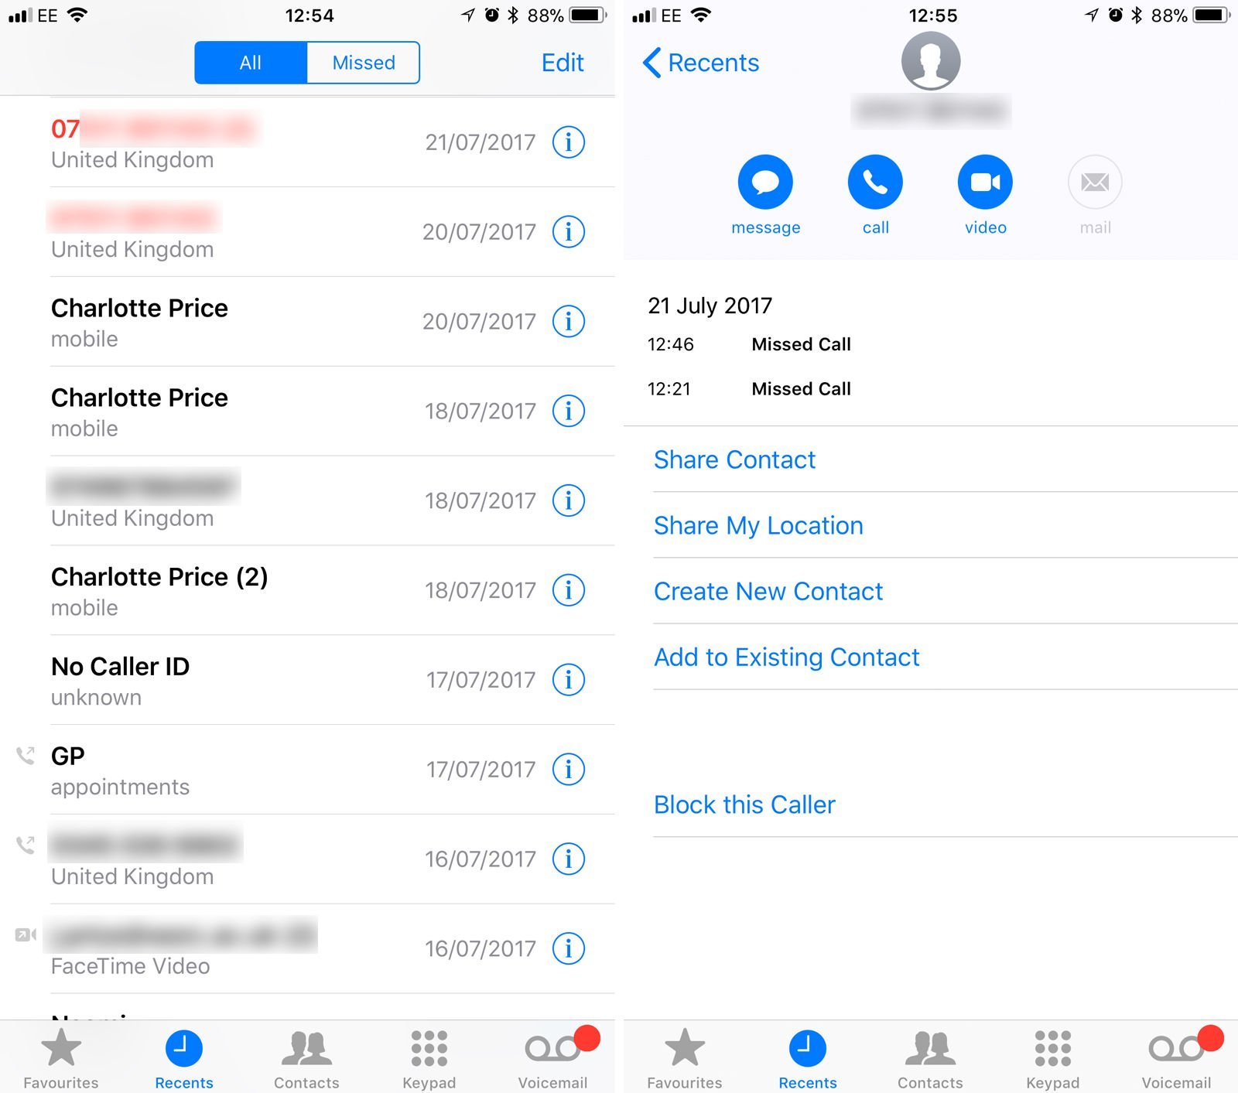
How to Block a Call?
Touch Phone
Touch Recent
Find Unwanted Caller
Touch
Touch Block this Caller
Back to Recent
Delete on Call List

Slide 40
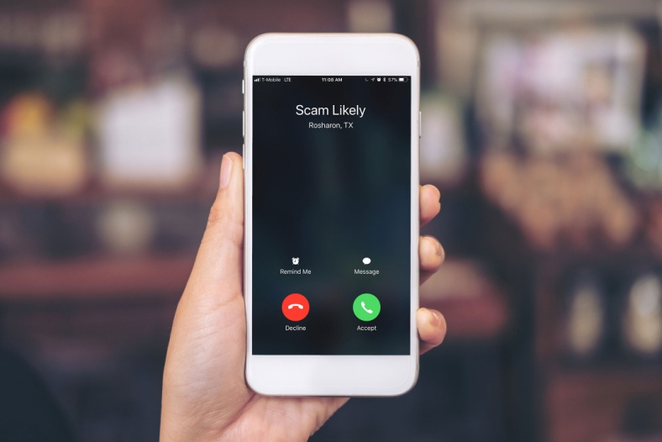
More Ways to Block
Cell Phone Carrier Blocking
FCC is Working with Cell Carriers on Blocking
Check with Your Cell Phone Carrier
Free Options
Apps that Block Scam Calls
Robo Shield
True Caller
Robo Killer
Hiya
Check to see if they are Free or a Fee

Slide 42
Contact Us
Bill Vicary
Just Call Bill
Technology Service Provider for Senior Adults and Families
864.621.0224
bill@vicarymanagementgroup.com
www.justcallbill.net
This is the property of Vicary Management Group, LLC and Just Call Bill. This information in this presentation cannot be duplicated or used without written permission. All rights reserved. 2020

